Slide 1
Team Name Conceptual Design Review
University/Institution
Team Members
Date

Slide 2
Template Notes
You can reformat this template to fit your design, but you must cover all the information requested on the following slides
This template contains all of the information you are required to convey at the CoDR level. If you have questions, please contact me directly: rocksatx@gmail.com

Slide 3
Template Notes
The Goals of the CoDR are:
Clearly present a concept of your payload
Science objectives (theory, background, and what mission will prove) are understood and well-defined
Preliminary mission requirements are defined and traceable to science objectives
Understand concept of operations
Understand mechanical and electrical interfaces

Slide 4
CoDR Presentation Content
Section 1: Mission Overview
Mission Statement
Mission Objectives
Theory and Concepts
Concept of Operations
Expected Results
Section 2: Design Overview
Science Design
Engineering Design
Functional Block Diagram
Payload Layout (sketches)
RockSat-X User’s Guide Compliance

Slide 5

CoDR Presentation Contents
Section 3: Management
Team Organization
Schedule
Budget
Mentors (Faculty, industry)
Risks/Worries
Contact and Availability Matrices
Section 4: Conclusions
jessicaswanson.com

Slide 6
Mission Overview
Name of Presenter(s)

Slide 7
Mission Overview: Mission Statement
Present a concise Mission Statement
What do you expect to discover or prove?
Who will this benefit/what will your data be used for?
Make your case as to why this mission should fly on a rocket

Slide 8
Mission Overview: Mission Objectives
Mission Objectives → derived from mission statement
Break down mission statement into your mission objectives
Minimum success criteria
What is the least amount of data you can collect that will still constitute a success?

Slide 9
Mission Overview: Theory and Concepts
Give a brief overview of the underlying science concepts and theory
What other research, if any, has been performed in the past?
Results?

Slide 10
Mission Overview: Expected Results
Go over what you expect to discover and what you data might look like
Ex. What wavelengths do you expect to see? How many particles do you expect to measure? How well do you expect the spin stabilizer to work (settling time?)? How many counts of radiation? Etc
This is vital in showing you understand the science concepts

Slide 11
Mission Overview: Concept of Operations
Based on science objectives, present a diagram of what the payload will be doing during flight, highlights areas of interest
Looking for a general layout of when things will happen (don’t need exact times)
Example on following 2 slides

Slide 12
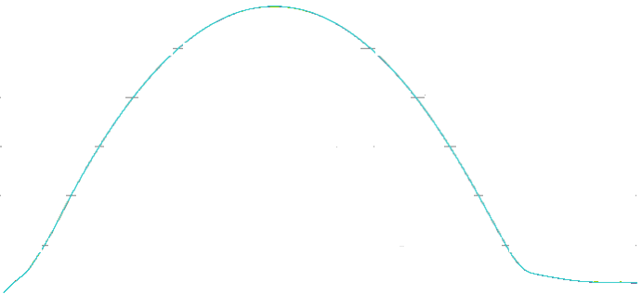
Example #1 ConOps
Altitude
t ≈ 1.7 min
Altitude: 95 km
Event B Occurs
t ≈ 4.0 min
Altitude: 95 km
Event C Occurs
t ≈ 1.3 min
Altitude: 75 km
Event A Occurs
Apogee
t ≈ 3.1 min
Altitude: ≈150 km
t ≈ 4.5 min
Altitude: 75 km
Event D Occurs
End of Malemute Burn
t ≈ 0.6 min
Altitude: 52 km
t ≈ 7.5 min
Chute Deploys
t = 0 min
-All systems on
-Begin data collection
t ≈ 15 min
Splash Down

Slide 13
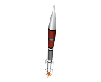
Example #2 ConOps
1. Launch
Telemetry/GPS begins
2. Launch to Apogee
Telemetry/GPS continues
3. Apogee
Nose cone separation
Skin separation
De-spin to TBD rate
Option to align with B Field
Telemetry/GPS continues
4. Descent
Telemetry/GPS continues
5. Chute Deploy
Telemetry/GPS continues
6. Landing
Telemetry/GPS terminates
Payloads recovered
3
4
5
2
1
6

Slide 14
Design Overview
Name of Presenter(s)

Slide 15
Design Overview: Science Design
Summarize the instrumentation/sensors/devices that will be used to complete your science mission
Present a concept of HOW your science hardware will work to achieve your mission

Slide 16
Design Overview: Engineering Design
Describe/summarize your current design used to support your Science Design
Be sure to cover major subsystems like Structures, Power, Command and Data Handling, Software
Utilization of heritage elements (designs/features used on previous flights) defined.
Major technology dependencies?

Slide 17
Design Overview: Functional Block Diagram
Functional block diagram
Shows HOW subsystems interact with each other
Shows HOW data will be recorded and stored
Shows HOW power and data flow through subsystems
Example on following slide
I will spend a lot of time on this diagram with each team and it will be referred to all the way up until launch so make it good

Slide 18
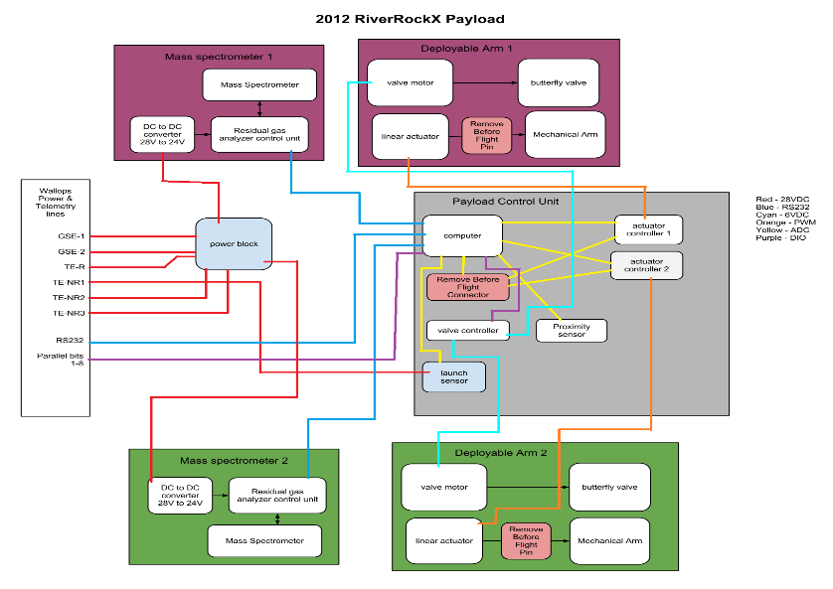
Example Functional Block Diagram

Slide 19
Design Overview: Payload Layout
Initial drawings/sketches/layout of your deck
Conceptual idea of how and where things will be mounted
Show where electronics boards (~how many?), sensors, power will be mounted
Rough dimensions and weight estimates

Slide 20
Management
Name of Presenter(s)

Slide 21
Management
Team organization chart
Preliminary schedule for the semester
Monetary budget
Team mentors (industry, faculty)?
Contact Matrix (available in welcome package)
Team Availability (MDT) Matrix (available in welcome package)

Slide 22
User Guide Compliance: Summary
At this point, you likely will not know a lot of this information. It is included in this presentation because these are things you need to keep in mind and MUST comply with in order to be able to fly. Please still fill it out to the best of your ability.

Slide 23
User Guide Compliance: Summary
Requirement | Status/Reason (if needed)
Center of gravity in 1" plane of plate?
Weight 30.0+/- 1.0 (15.0 +/- 0.5) lbs?
Max Height < 10.75” (5.13”)
Bottom of deck has flush mount hardware?
Within Keep-Out Zone
Using < 10 A/D Lines
Using/Understand Parallel Line
Using/Understand Asynchronous Line
Using X GSE Line(s)
Using X Non-Redundant PWR Lines (TE-1, TE-2, TE-3)
Using X Redundant Power Lines (TE-R)
Using < 1 Ah
Using <= 28 V
Using RF (If yes, list frequency and TX Power)
Using deployable?
Whole team consists of US Persons
Using ITAR and/or Export Controlled hardware

Slide 24
User Guide Compliance: Summary (example)
Requirement | Status/Reason (if needed)
Center of gravity in 1" plane of plate? | 1.2" currently
Weight 30.0+/- 1.0 (15.0 +/- 0.5) lbs? | 31.5 lbs (working on reducing)
Max Height < 10.75” (5.13”) | 10.9 inches (waiver requested)
Bottom of deck has flush mount hardware? | YES, see picture on slide XX
Within Keep-Out Zone | YES, see picture on slide XY
Using < 10 A/D Lines | Using on 8 lines
Using/Understand Parallel Line | N/A
Using/Understand Asynchronous Line | YES, at 19200 Baud
Using X GSE Line(s) | YES, GSE 1 and GSE 2
Using X Non-Redundant PWR Lines (TE-1, TE-2, TE-3) | YES, TE-1 and TE-2
Using X Redundant Power Lines (TE-R) | YES, TE-R
Using < 1 Ah | 1.1 (working on reducing)
Using <= 28 V | 200 V (Will conformal coat)
Using RF (If yes, list frequency and TX Power) | YES, 134.34 MHz @ 1 watt TX power
Using deployable? | YES, but speed is under 1 inch per second
Whole team consists of US Persons | YES
Using ITAR and/or Export Controlled hardware | NO

Slide 25
Risks/Worries:
What are your biggest worries or potential failure points with your conceptual design?
Items identified should be completely mitigated through your design effort and fully addressed by CDR

Slide 26
Conclusion
Address why your mission deserves to fly
Next steps for your team to get to PDR
Anything you need to investigate further?
Begin requirement flow down process for system and subsystems

